Slide 1
FLIGHTS PRICE PREDICTION
Submitted By:-
Rishabh Johri
Data Science - Intern

Slide 2
ACKNOWLEDGEMENT:-
It is a great pleasure to express my gratitude to Team Flip Robo, for giving me the opportunity to work on a interesting project, which helped me in improving my knowledge, coding skills and my analysation skills.
Team Flip Robo also gave me opportunity to build PowerPoint Presentation and Project Report, which will help me to share steps taken while building the entire model. It has helped me in deciding about the future prospects of various Data Science fields. Now, I will explain the understanding of the project through this report.

Slide 3
INTRODUCTION OF PROJECT :-
The tourism industry is changing fast and this is attracting a lot more travellers each year. The airline industry is considered as one of the most sophisticated industry in using complex pricing strategies. Nowadays, flight prices are quite unpredictable. The ticket prices change frequently. Customers are seeking to get the lowest price for their ticket, while airline companies are trying to keep their overall revenue as high as possible. Using technology, it is actually possible to reduce the uncertainty of flight prices. So here we will be predicting the flight prices using efficient machine learning techniques.
Airline : The Name of flight.
Travel Date: The date when the journey starts from the source.
From: From Which destination to fly.
To : The destination where to arrive
Departure Time :- Time when the flight takes off.
Arrival Time :- Time when the flight arrives at the destination.
Stops:- Number of layovers in between reaching destination.
Price: The price of the ticket.

Slide 4
MOTIVATION FOR THE PROBLEM UNDERTAKEN:-
For Modelling this dataset, Flight Price Prediction with all given available independent variables. This model will then be used for management of how the customer will be able to spend money on high priced tickets based on the independent variables. With the help of this prediction model, it will be decided accordingly and manipulate the strategy of the firm and concentrate on areas that will yield high returns. Further, the model will be prediction based insights to the management to understand whether the customer will pay the suitable price as compared to high priced flight Fares.

Slide 5
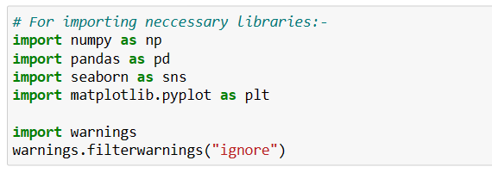
Importing Libraries:-
Here, we are importing all the libraries which are required for EDA, visualization, prediction and finding all matrics. The reason of doing this is that it become easier to use all the import statement at one go and we do not require to import the statement again at each point.

Slide 6
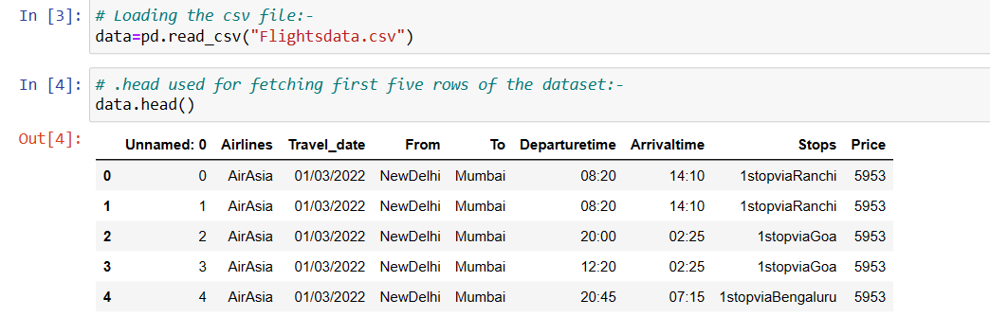
Data Sources and their Formats:-
Now I am going to upload or read the files/datasets using pandas. For this I have used read_csv method:-

Slide 7
Some EDA steps:- 1. For checking the rows and columns present in the dataset Command Used:- data.shape 2. For Checking the null values in the dataset:- Command used:- data.isnull().sum() 3. For checking the available columns in the dataset: Command used:- data.columns
4. FOR CHECKING THE DATATYPE OF EACH FEATURES:-
Command Used:- data.dtypes()
5. FOR OBSERVING THE INFORMATION ABOUT DATASET:-
Command Used :- data.info()

Slide 8
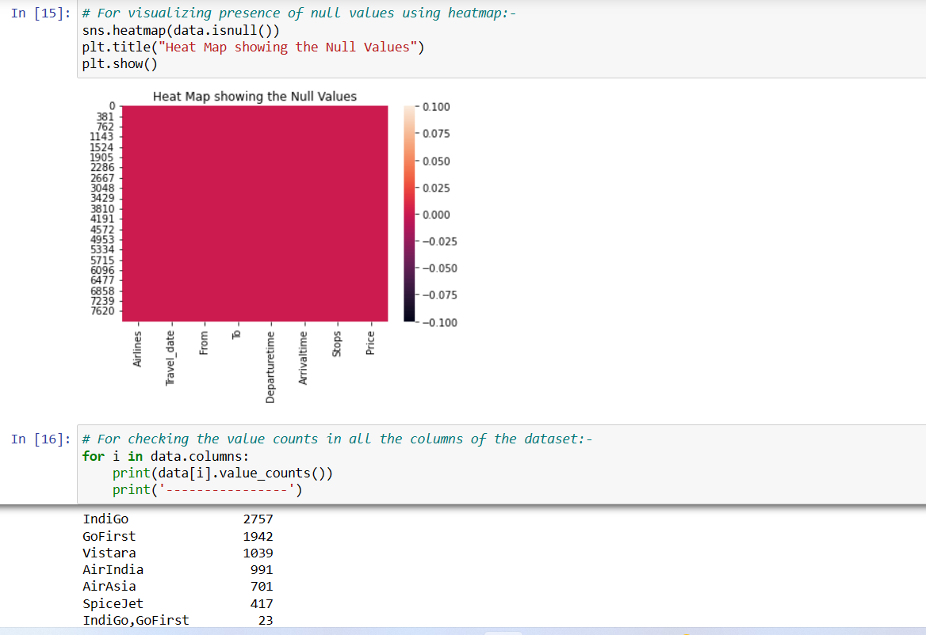
DATA VISUALISATIONS:-

Slide 9
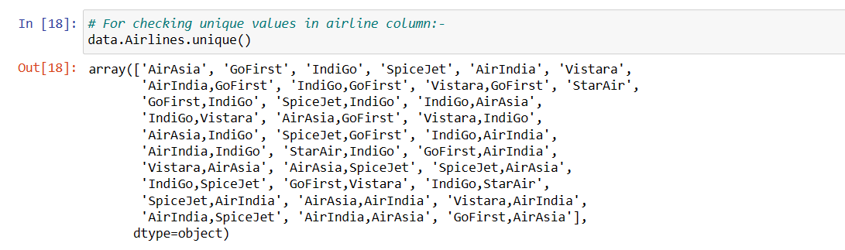
For Unique Values:-

Slide 10
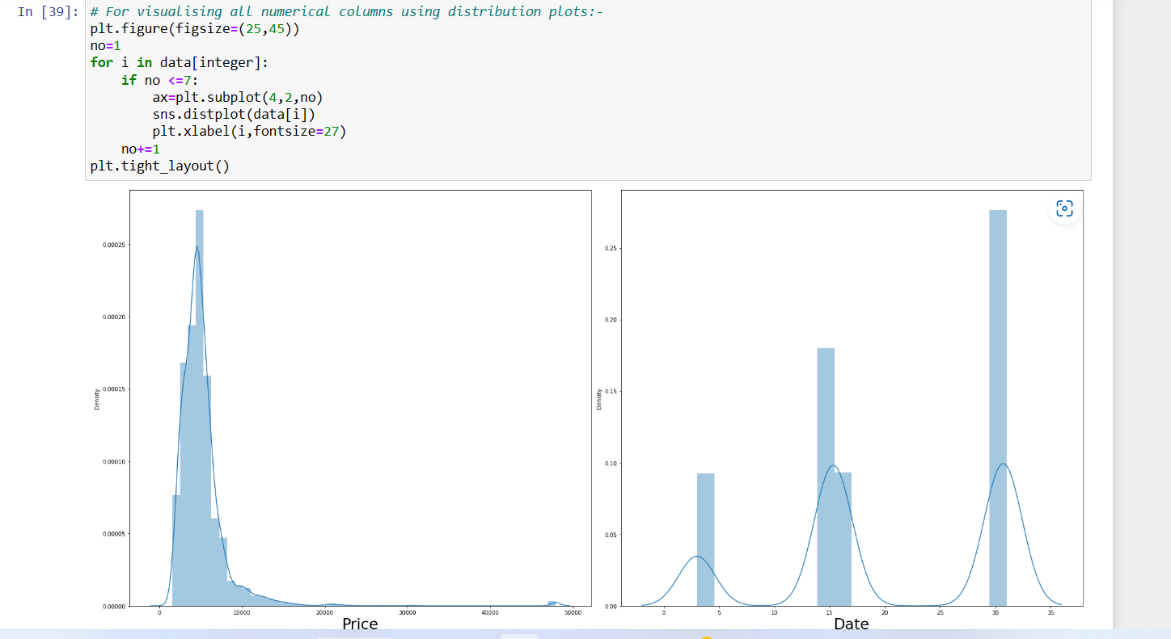
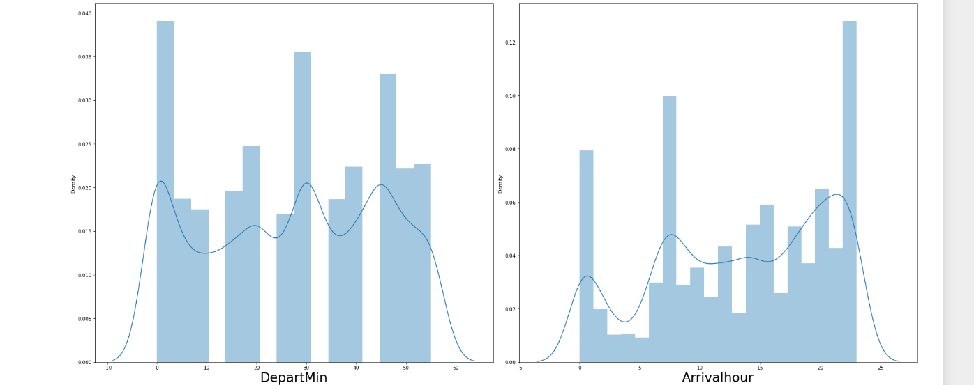
USING DIST PLOT:-

Slide 11
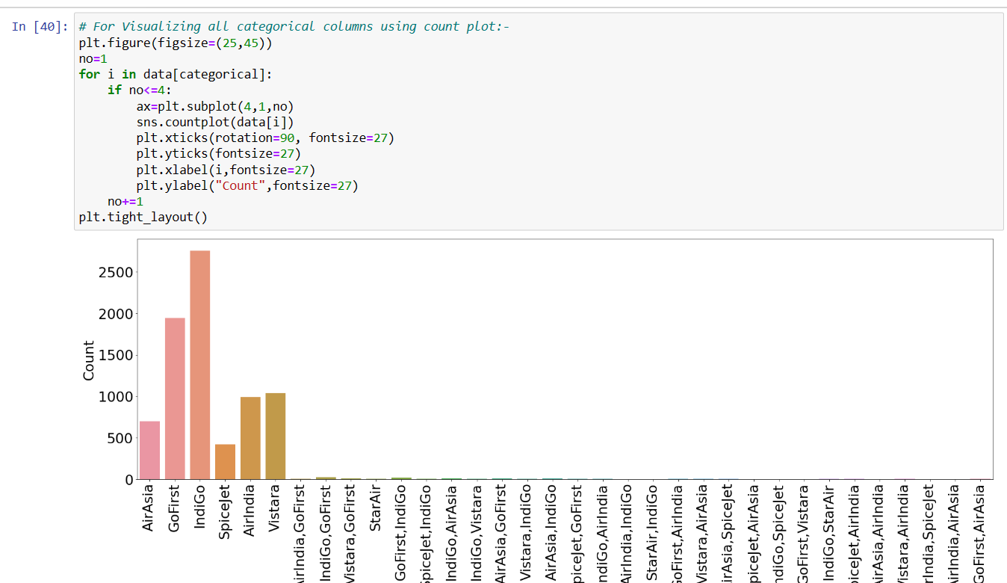
For Visualising Categorical columns:-

Slide 12
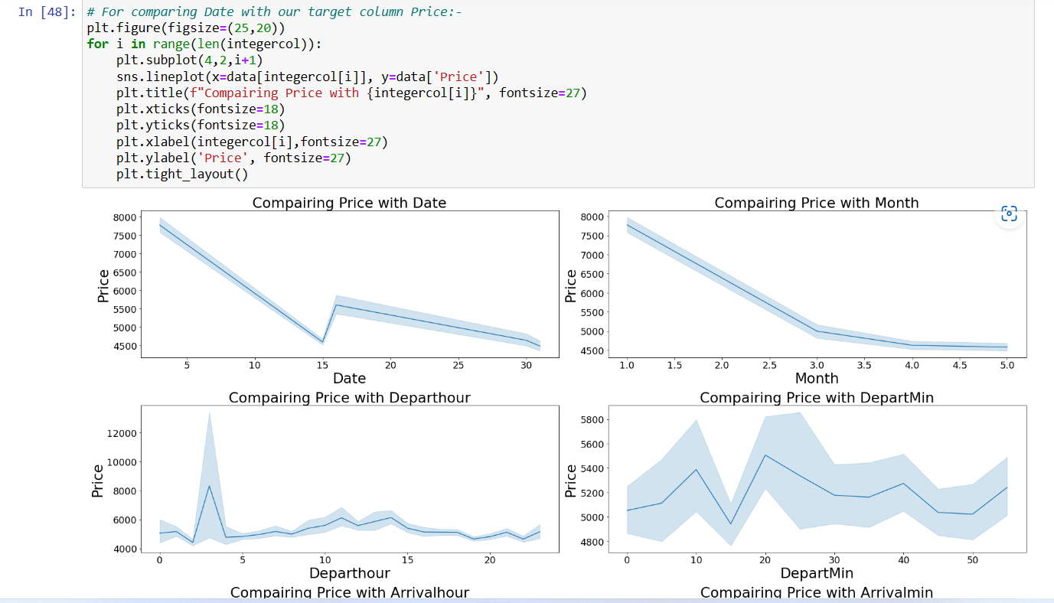
For Comparing Date with Target column:-

Slide 13
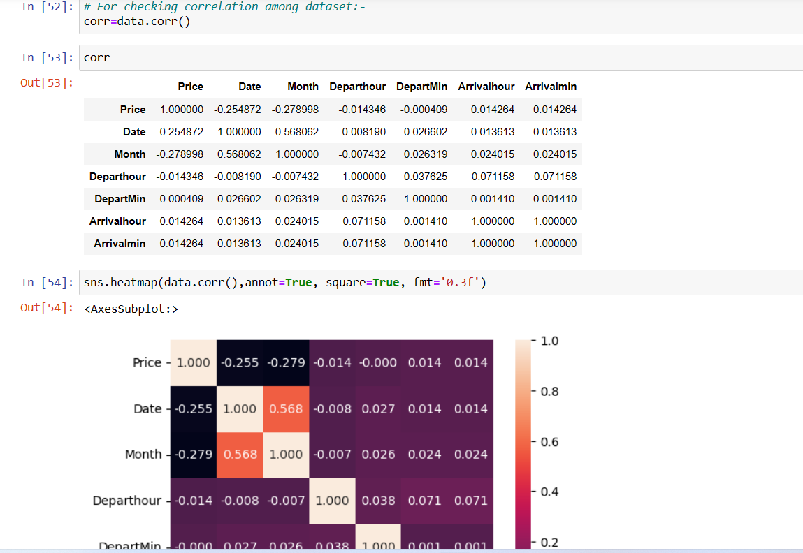
Correlation:-

Slide 14
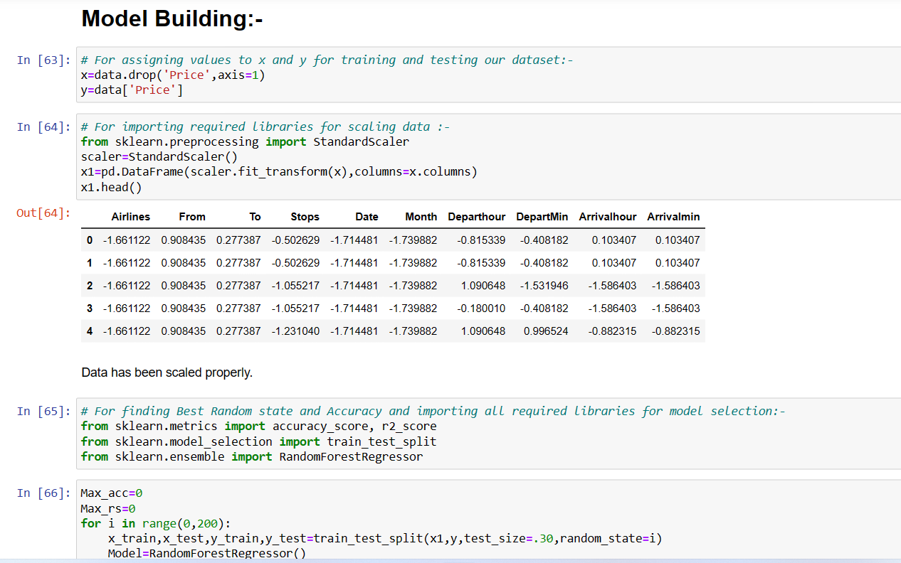
Model Building Phase:-

Slide 15
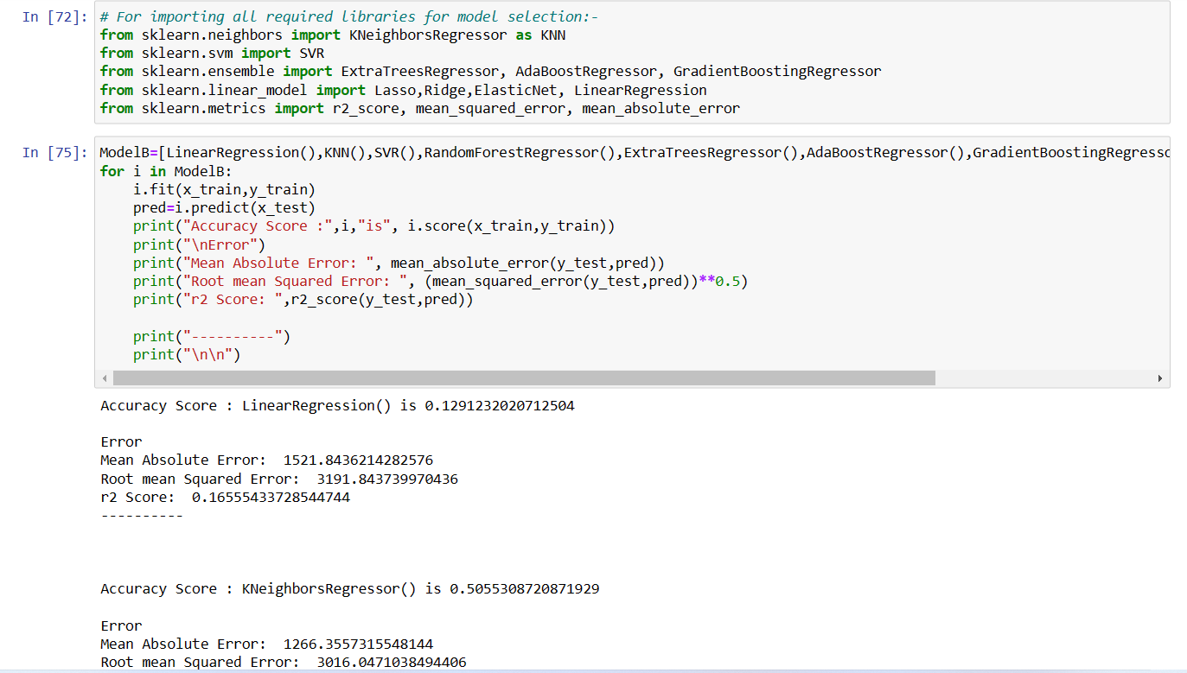
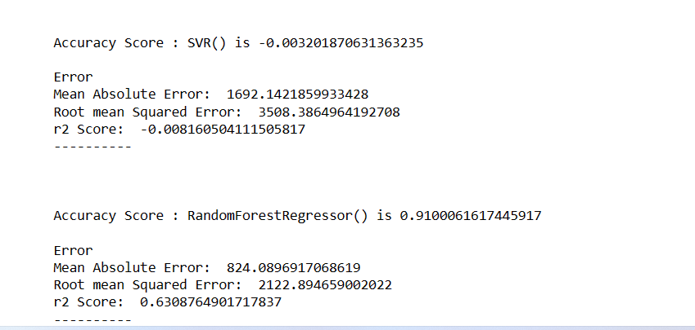
Different Model Scores:-

Slide 16
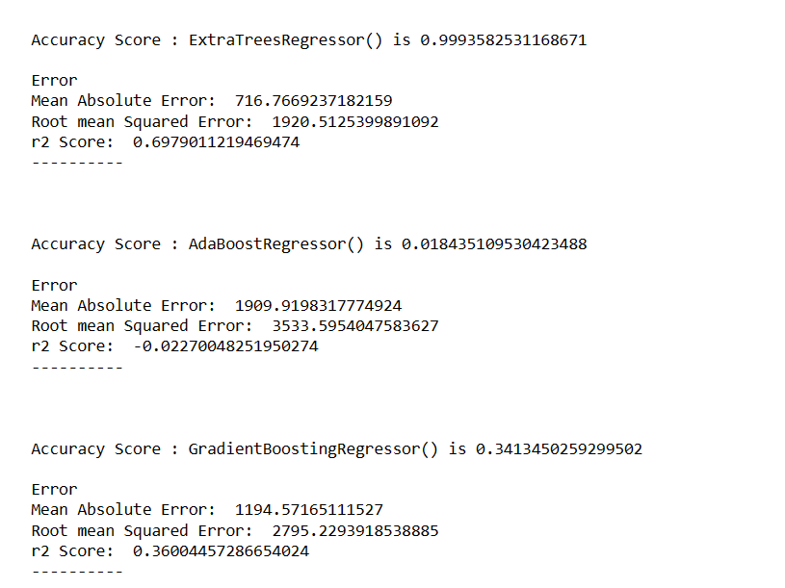

Slide 17
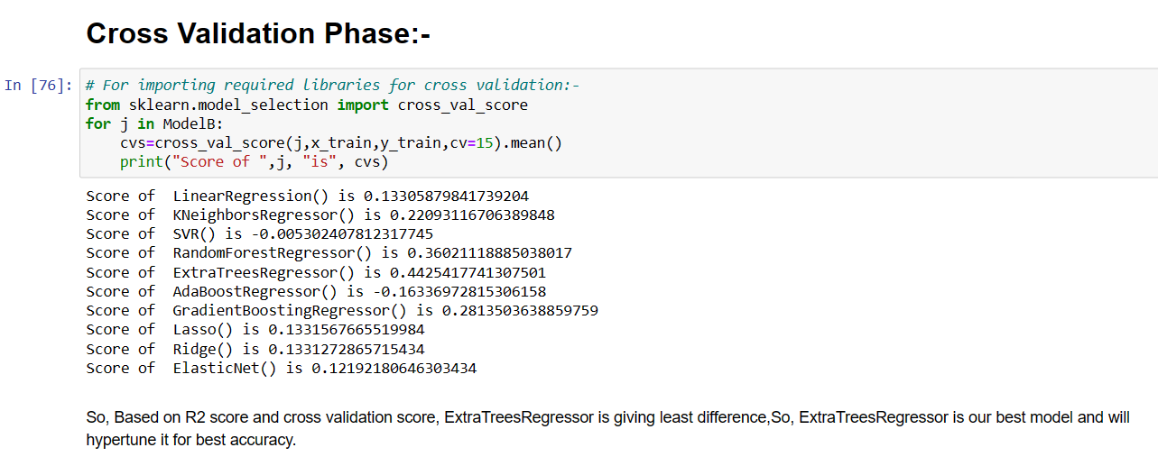
Cross Validation Phase:-

Slide 18
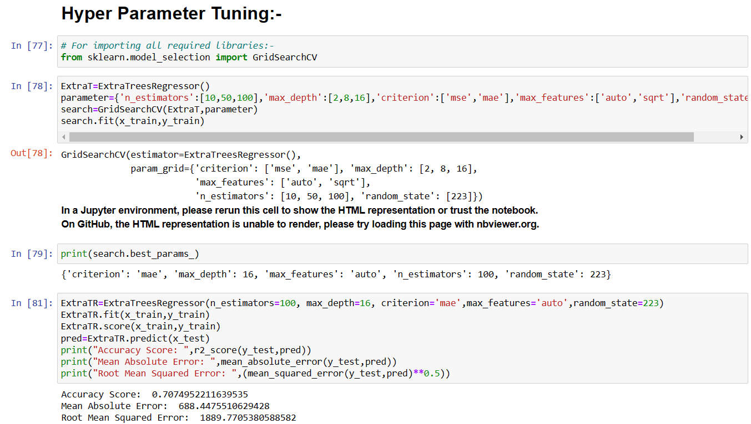
Hyper Parameter Tuning:-

Slide 19
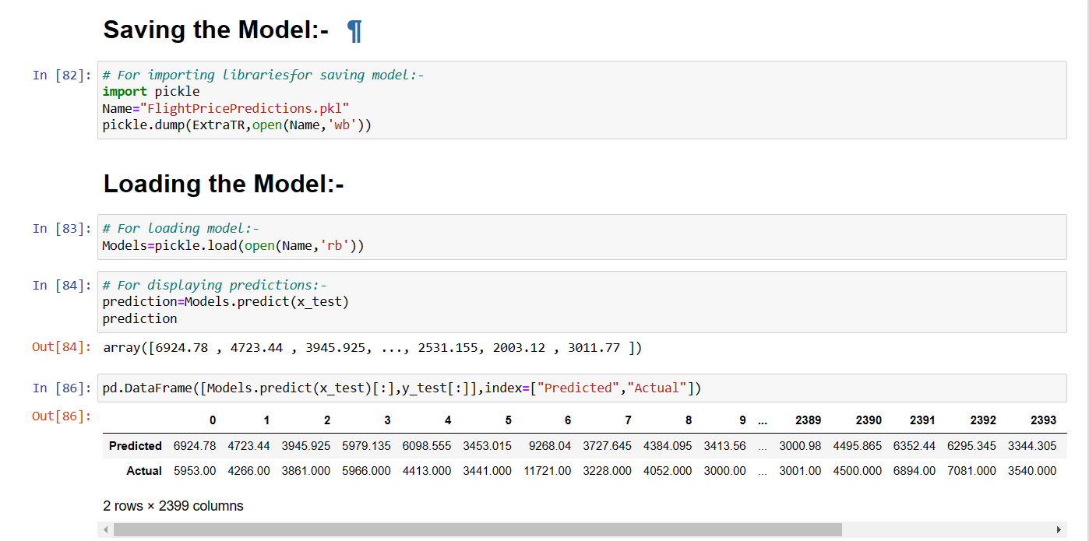
Saving and Loading Predictions:-

Slide 20
Interpretation of the Results:-
• I have used Data visualization tools such as dist Plot, Count Plot for categorical data and line plot to understand the data in a better way.
• I have done the model building process with several algorithms and finalise the best model as Extra Trees Regressor with an accuracy score of 71% after Hyper Parameter Tuning.

Slide 21
CONCLUSION:-
The overall survey for the dynamic price changes in the flight tickets is presented. This gives the information about the ups and downs in the airfares according to the days, weekend and time of the day that is morning, evening and night. Also, the machine learning models in the computational intelligence field that are evaluated before on different datasets are studied. Their accuracy and performances are evaluated and compared in order to get better result. For the prediction of the ticket prices perfectly different prediction models are tested for the better prediction accuracy. As the pricing models of the company are developed in order to maximize the revenue management, so to get the result with maximum accuracy regression analysis is used. From the studies , the feature that influences the prices of the ticket are to be considered. In future, the details about number of available seats can improve the performance of the model

Slide 22
THANK YOU

